Slide 1

IBM HUMAN
RESOURCES
ANALYTICS
OCTOBER 2024
Under the Supervision of Eng. Ahmed Radwan

Slide 2







TEAM MEMBERS
Mennatullah Taha
Aml Abdo Zayed
Salma Abdrabou
Eng / Ahmed Radwan
Abdelrhman Aleskandrany
Ahmed Khoukh
Al-Qasem Ezzaldeen

Slide 3

Agenda
01
07
Problem Statement
Eploratory Data Analysis
02
08
Forecasting and Trend Analysis
Objectives
03
09
Data Overview
Dashboard
04
10
Project Scope
strategic Recommendations
05
11
Key Analysis Questions
conclusion
06
Data Preprocessing

Slide 4


Problem Statement
Employee attrition, satisfaction, and performance are critical factors in maintaining a productive workforce. High turnover, low job satisfaction, and poor work-life balance can negatively impact company success. This project aims to analyze and predict key HR outcomes using historical employee data to help decision-makers address potential issues proactively.

Slide 5



Key Objectives
01
Analyze Employee Attrition:
02
Assess Monthly Income:
Identify employees likely to leave the company using factors such as age, income, job satisfaction, overtime, and work-life balance.
Forecast employee salary based on features like age, years at the company, job satisfaction, and performance rating.
03
Evaluate Employee Performance:
04
Measure Job Satisfaction:
Investigate the impact of job involvement, job satisfaction, and years at the company on employee performance ratings.
Analyze the factors influencing employee job satisfaction, focusing on work-life balance, overtime, and training opportunities.

Slide 6
Project Scope
01
Data Cleaning and Preparation
02
Exploratory Data Analysis (EDA)
Clean and preprocess employee data, including demographics, job satisfaction, performance ratings, and attrition status.
Analyze employee attributes to identify patterns and relationships affecting attrition, income, and performance..
03
Predictive Modeling
Data Visualization
04
Create models to analyze factors influencing employee satisfaction and performance ratings..
Develop dashboards to effectively communicate insights and findings.
05
Recommendations and Strategies
Formulate actionable strategies based on the analysis to enhance employee satisfaction, retention, and overall performance.

Slide 7
Data Overview
Data
Source
Data
Features
Data
Size
Data Quality
Issues

Slide 8
Data Source
The dataset is sourced from Kaggle: IBM HR Analytics Attrition Dataset. It includes detailed information on employee attributes and performance metrics used to analyze attrition, satisfaction, and other key HR-related outcomes.

Slide 9
Data Size
Data Volume: 1,470 employee records.
Features: 35 columns (fields).
File Size: The dataset is relatively small, around 200KB.
File Type: .CSV File

Slide 10
Data Features
Attrition: Indicates whether an employee has left the company.
JobSatisfaction: Employee's level of satisfaction with their job.
YearsAtCompany: The number of years the employee has worked at the company.
OverTime: Whether the employee works overtime.
WorkLifeBalance: Employee's perception of work-life balance.
PerformanceRating: Employee's performance rating, typically on a scale of 1 to 4.

Slide 11
Data Quality Issues
Missing Values: There are missing values in the age, dailyrate,jobsatisfaction,and years at company columns.
Irrelevant Columns: columns like Over18, EmployeeCount, StandardHours, and EmployeeName contain redundant or non-informative data.
Low Variability: Certain columns (e.g., EmployeeCount, Over18) have only one unique value, providing no analytical value.

Slide 12
Data Quality Issues
Duplicate Records: No explicit check for duplicate rows is shown, which could exist in the dataset.
Format Issues: Ensure categorical fields are properly encoded for analysis (e.g., Attrition, BusinessTravel).

Slide 13
Data Preprocessing
[pandas]

Slide 14
Process Steps
Dropping Irrelevant Columns: Removed columns with only one unique value or unnecessary.
2.Handling Missing Values:
Filled missing values in numerical columns with the median.
Filled missing values in the categorical column with the mode.
3.Data Export: Saved the cleaned DataFrame to a new CSV file ("Clean_data.csv").

Slide 15
Key Analysis Questions [SQL]

Slide 16
Key Questions
1. Is there a relationship between salary (MonthlyIncome) and job performance?
2. Do employees with higher job satisfaction receive better performance ratings?
3. How do stock options affect employee retention?
4. Does the number of hours worked (OverTime) impact job satisfaction?
5. Do younger employees leave the company more frequently than older employees?
6. What are the differences in satisfaction levels between male and female employees?
7. Are employees in certain educational fields more likely to have higher job satisfaction?
8. Do employees who frequently switch companies (NumCompaniesWorked) have higher attrition rates?

Slide 17
Key Questions
9. How does promotion history (YearsSinceLastPromotion) correlate with job satisfaction and retention?
10. Which department has the highest satisfaction level among employees?
11. Does frequent business travel affect employee retention or job satisfaction?
12. How does distance from home (DistanceFromHome) impact employee retention or satisfaction?
13. How do training opportunities (TrainingTimesLastYear) affect employee satisfaction and retention?

Slide 18
Exploratory Data Analysis
[Matplotlib] [Seaborn] [Plotly]
Key
Visuals
Initial
Insights
Explain
findings

Slide 19
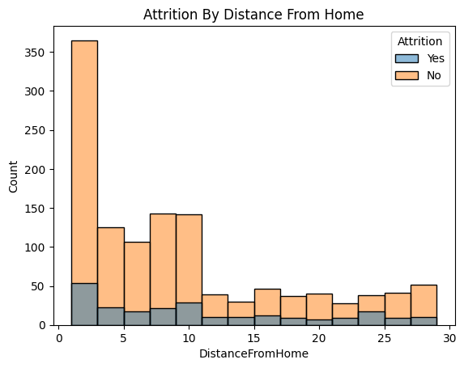
Attrition By Distance From Home
Employees closer to the workplace have higher attrition rates, which decrease as distance increases.

Slide 20
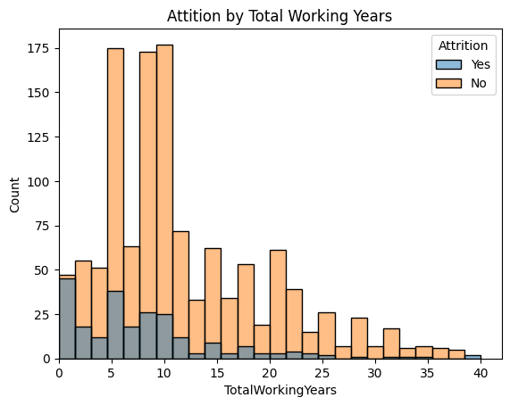
Attrition By Total Working Years
The Histogram shows that fresh employees are exposed to attrition more than those with experience.

Slide 21
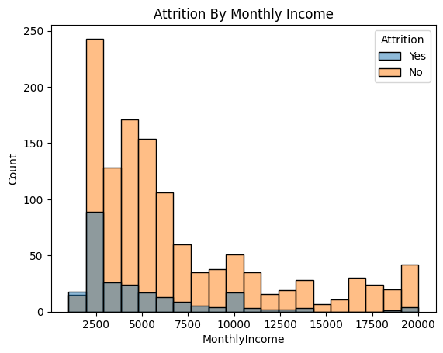
Attrition By Monthly Income
The Histogram shows that employees with lower monthly incomes tend to leave the company more.

Slide 22
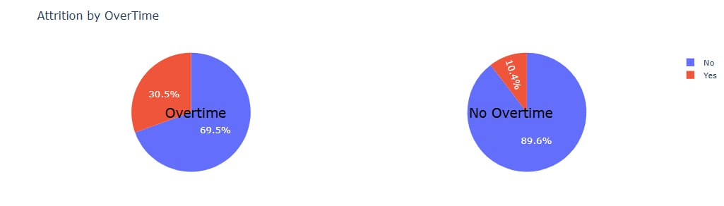
Attrition By OverTime
The Pie Charts of Attrition by Overtime.
The left chart shows attrition for employees working overtime, while the right chart shows attrition for those not working overtime.

Slide 23
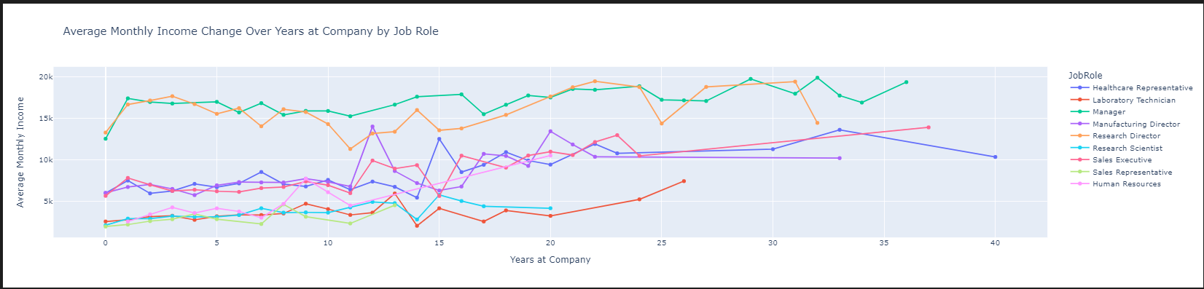
Monthly Income Growth by Job Role Over Time
The Line Chart shows how the average monthly income varies with years at the company, broken down by job roles. It highlights income trends over time for different roles.

Slide 24
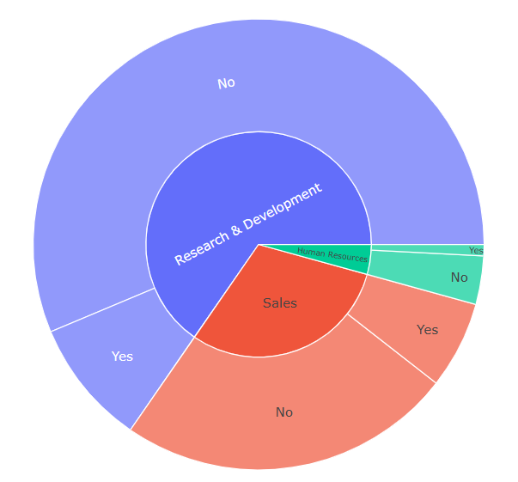
Attrition Distribution in Departments
Sunburst Chart visualizes the hierarchical relationship between Departments and Attrition status. It provides insight into attrition distribution across departments.

Slide 25
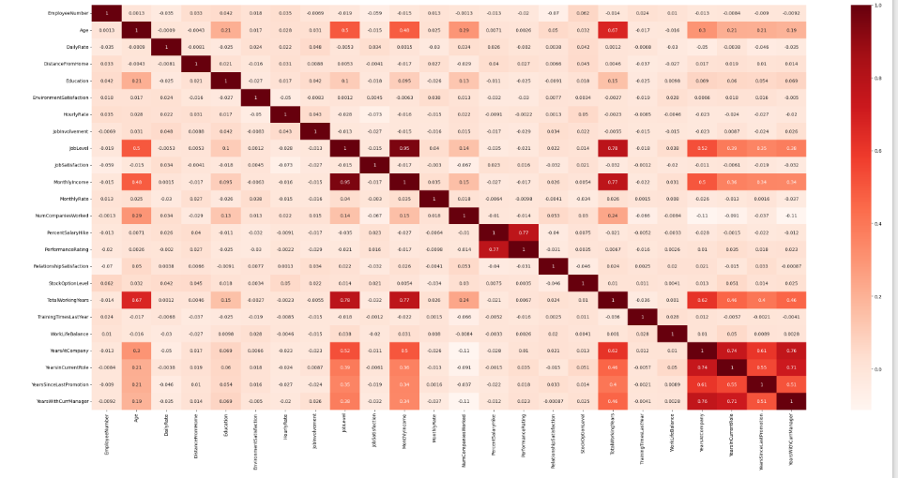
Features Heatmap
This correlation heatmap shows the strength of relationships between variables.
Light Shades for Weak or no correlation between variables and Dark Shades for Strong correlation between variables

Slide 26
Forecasting and Trend Analysis
[Sklearn] [Imblearn]
Model’s
Function
Model
Performance
Explain
Findings

Slide 27
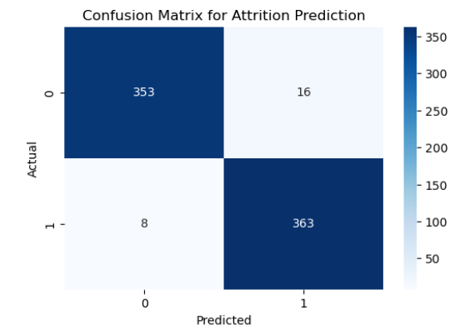
Predicting Employee Attrition with Random Forest Classifier
Confusion Matrix displays the performance of the Random Forest Classifier for predicting employee attrition, showing counts of true and false predictions.
The model achieved an accuracy of [96%].

Slide 28
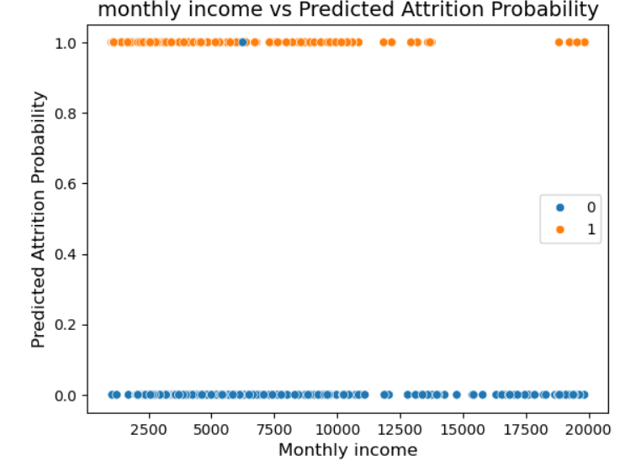
monthlyIncome vs Predicted Attrition Probability
This scatter plot illustrates the relationship between monthly income and Predicted Attrition Probability. The colors differentiate the actual outcomes, allowing us to understand how monthly income affects the likelihood of attrition.

Slide 29
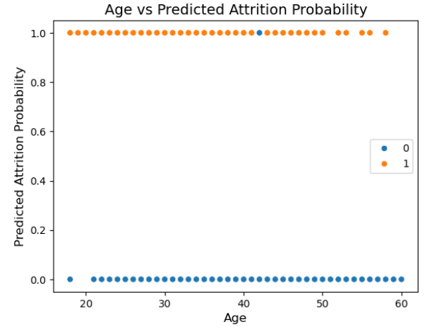
Age vs Predicted Attrition Probability
This scatter plot illustrates the relationship between Age and Predicted Attrition Probability. The colors differentiate the actual outcomes, allowing us to understand how age affects the likelihood of attrition.

Slide 30
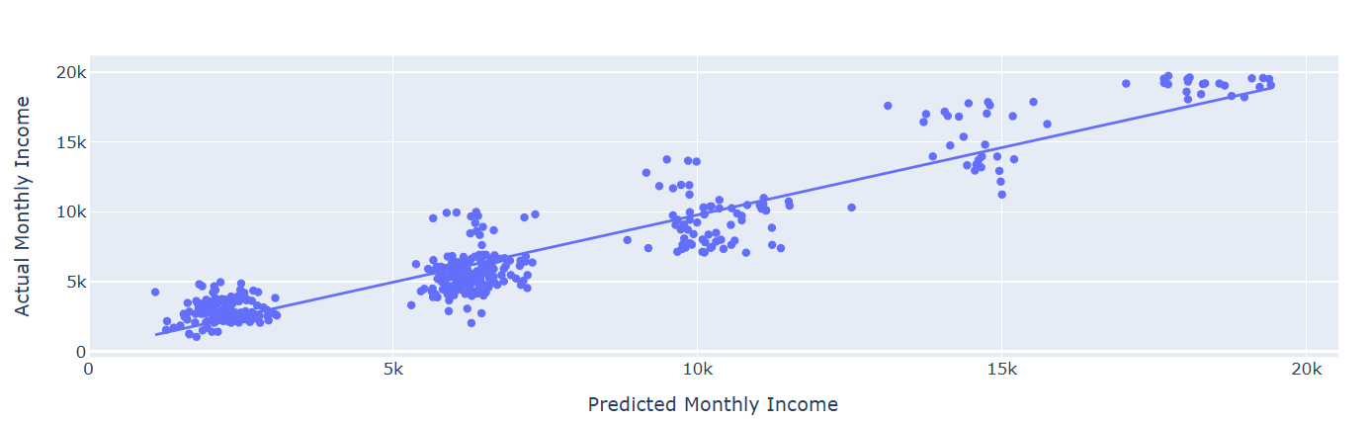
Predicting Employee Attrition By Income Salary
This Scatter Plot illustrates the relationship between predicted and actual monthly income values from the Linear Regression model.
It includes a trendline, with the model achieving a Mean Squared Error of 2307326.37 and an R² Score of [ 89%] .

Slide 31
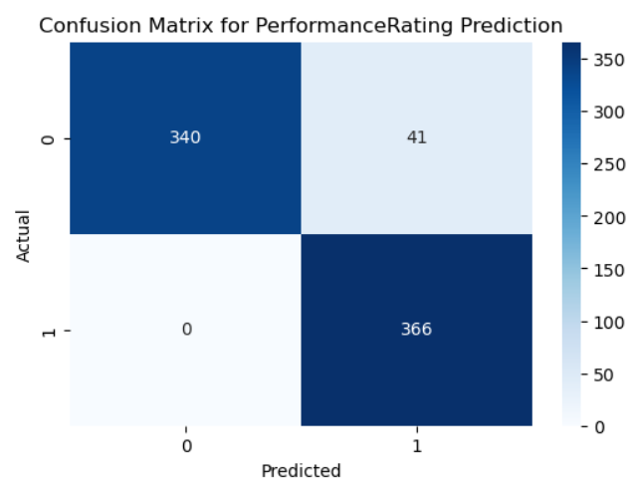
Predicting Employee Performance
Confusion Matrix for Performance Rating Prediction shows the accuracy of the Logistic Regression model by displaying true and false predictions for each class.
The model achieved an accuracy of [95% ]

Slide 32
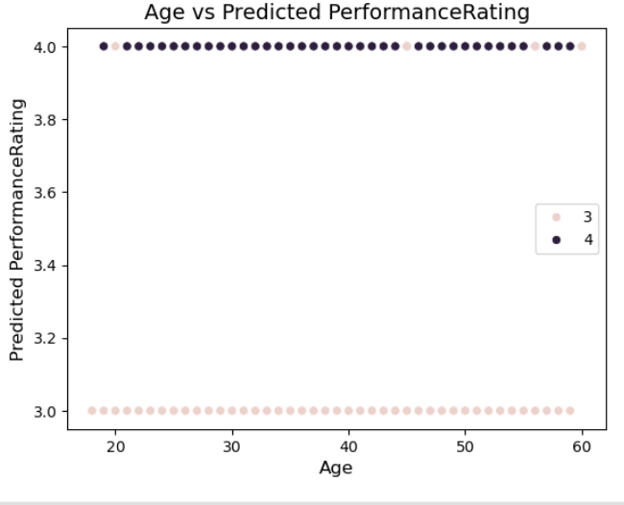
Age vs Predicted PerformanceRating
This scatter plot displays the correlation between Age and Predicted Performance Rating. The varying colors indicate actual performance outcomes, enabling us to observe the influence of age on predicted performance ratings

Slide 33
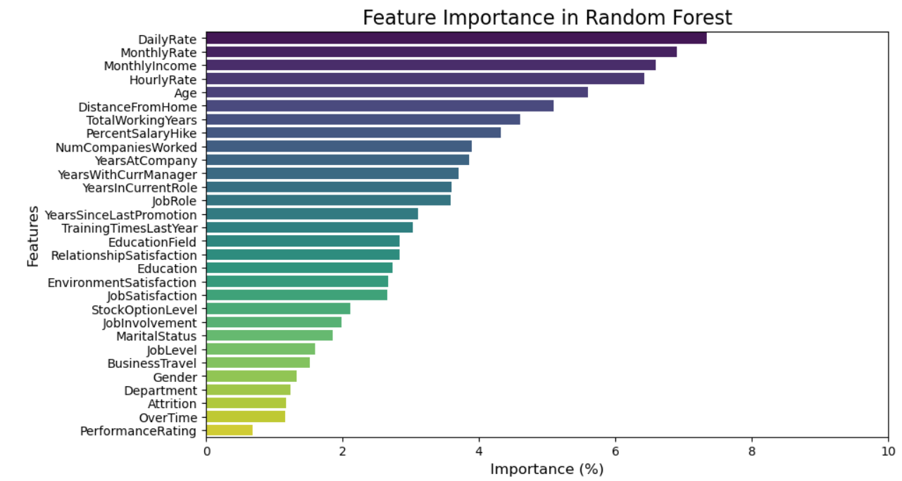
Predicting Feature Importance
Feature Importance Bar Chart shows the significance of features in predicting WorkLifeBalance using a Random Forest Classifier.
The model achieved an accuracy of [92%].

Slide 34
Dashboard
[Tableau]
Employee Overview
Attrition Overview
Salary
Overview

Slide 35
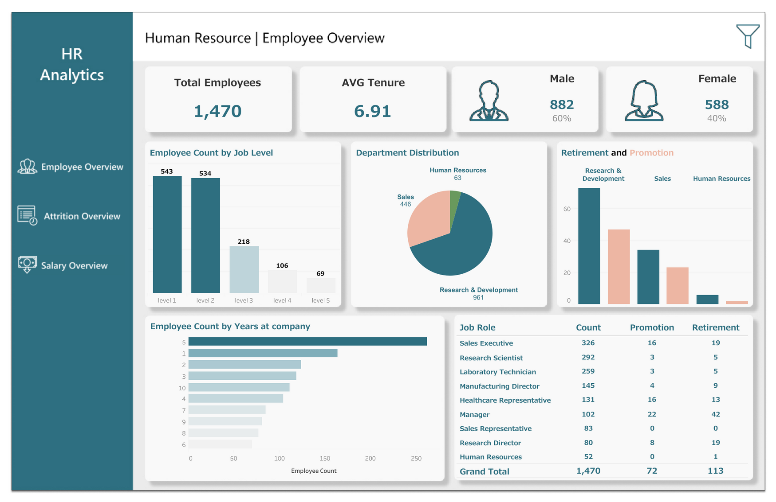
Employee Overview

Slide 36
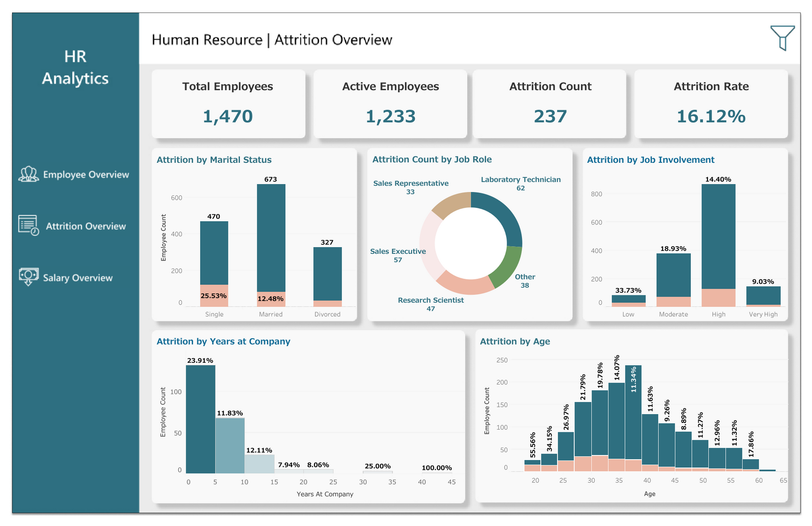
Attrition Overview

Slide 37
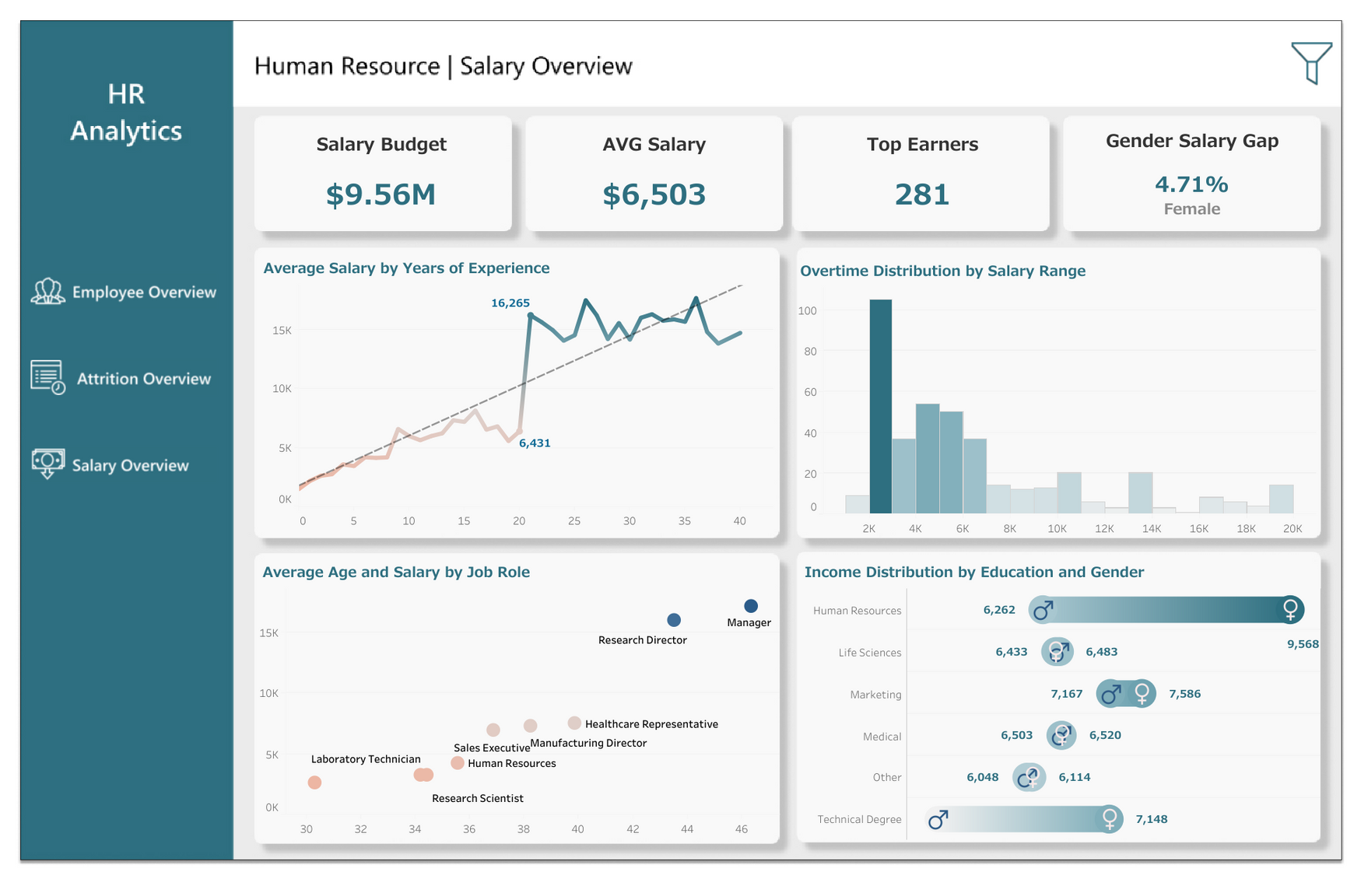
Salary Overview

Slide 38

strategic Recommendations
Enhance Work-Life Balance
Career Development Programs
Regular Feedback Mechanisms
Recognition and Reward Initiatives
Focus on Exit Interviews
Salary Adjustments
Monitor Workload

Slide 39
Enhance Work-Life Balance
Career Development Programs
Flexible work schedules and remote options reduce employee stress, improve work-life balance, and boost job satisfaction.
Training and development opportunities enhance employee skills, promote loyalty, and support career growth.

Slide 40
Recognition and Reward Initiatives
Focus on Exit Interviews
Recognition programs boost morale, enhance loyalty, and motivate employees to excel, fostering a positive work environment.
Exit interviews offer insights into employee turnover, helping management address issues and improve retention.

Slide 41
Monitor Workload
Salary Adjustments
Monitoring workloads prevents burnout, boosts productivity, and supports job satisfaction, improving employee retention.
Salary reviews ensure competitive pay, attracting and retaining talent, boosting employee satisfaction, and reducing turnover.

Slide 42

Regular Feedback Mechanisms
Establishing frequent channels for employee feedback helps identify concerns and areas for improvement, promoting a culture of open communication and making employees feel valued and heard.

Slide 43
conclusion
In conclusion, this project provides critical insights into the factors influencing employee attrition, such as work-life balance, compensation, and career development. These insights allow the organization to take targeted actions to improve employee retention, directly impacting business performance. Moving forward, the focus should be on refining retention strategies through continuous data analysis, implementing employee engagement initiatives, and measuring the effectiveness of interventions. This will help ensure that the company maintains a satisfied and motivated workforce, leading to long-term organizational stability and success.

Slide 44
ANY QUESTIONS ?

Slide 45
THANK
YOU

